Slide 1
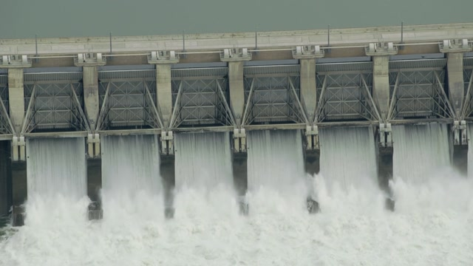

“Documents in Physical Form”
Online Bid Due Date : 12.11.2025
Department of Water Resources
Govt. of Odisha./OCC Ltd
BID identification No. OCCL-LSSP/01/2025-26
Project : Construction of In- stream Storage Structures at Kukedmal across river Tel including Hydro-Mechanical Works, Power Connectivity Works,Road Connectivity, Staff Quarters including Design and estimate of all Components with Operation and Maintenance of the project for a Period of five years or five Flood Seasons whichever
is more after successful commissioning of the project
Content Inside (in original) as per Clause 7 GENERAL INSTRUCTIONS-7.16 :
Original Bank Guarantee For EMD
To,
Managing Director ,
Odisha construction Corporation Bhubaneswar
unit VIII , Gopabandhu Nagar , Bhubaneswar, Odisha,
PIN-751012
Submitted by:
DILIP BUILDCON LIMITED
Plot No-5 Inside Govind Narayan Singh Gate, Chuna Bhatti, Kolar Road
Bhopal -462016 (M.P.)
Ph.-0755-4029999, Fax : 0755-4029998
Email: tender@dilipbuildcon.co.in,

